Slide 1


Trusts & Foundations Fundraising
2 August 2018
In partnership with:

Slide 2
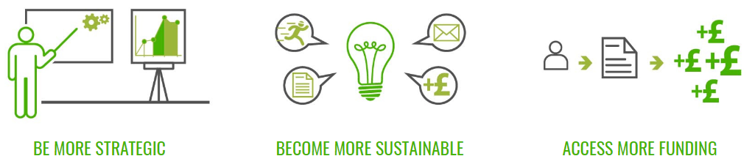
About Lime Green Consulting
Business planning
Facilitation
Theory of change
Fundraising strategy
Advice & mentoring
Case for support
New campaigns
Grant funding strategy
Prospect research
Template applications
Bid writing

Slide 3
What you’ll get from today
How to stand out from the crowd in a competitive climate.
How to add more quality and strategy to your trusts fundraising.
A chance to step back and consider what isn’t working and where you need to make improvements.
Some insight into the minds of funders, and how to appeal to them.
Advice on the most common trusts fundraising mistakes, and how to avoid them.
A buddy for the day – so you leave with some practical resources to put in place for your trusts fundraising!

Slide 4
Schedule
10:15 The state of the landscape – and your biggest challenges
The five key stages of a successful programme
10:50 Establishing your funding needs
11:30 Prospect research
11:50 Developing your case for support
13:00 Lunch
13:45 Writing brilliant applications
15:00 Record-keeping and relationship-building
15:15 Coffee break
Wrapping up
15:30 What funders say, what they really mean & what to do about it
16:15 Questions & feedback
16:30 Finish

Slide 5
Raising money from trusts and foundations: what are the challenges?

Slide 6
Self-assessment questions
Think about the following three questions…
How ready is your organisation to undertake trusts and foundations fundraising?
Considering your answer to Q1, how confident do you feel about applying to trusts and foundations?
What is your biggest strategic challenge with trusts and foundations fundraising?
0
10

Slide 7
Trusts & foundations:
State of the landscape

Slide 8

Trusts & foundations:
State of the landscape
The good news
The lifeblood of most organisations, especially smaller ones
Fund project costs, salary costs, start-up costs, capital projects, running/core costs
Give away £4.4 billion annually (DSC report 2015)
Top 300 give away £2.7 billion annually – 15% of all voluntary sector income! (Association of Charitable Foundations 2016)
Unique in existing solely to give away money
Unusually high return on investment (ROI) – potentially 10:1
If you know your work well, you can secure grants

Slide 9

Trusts & foundations:
State of the landscape
The challenges
Not as easy as it may seem – you need to:
  Carefully research funders that fit your organisation
  Tailor applications to their interests, guidelines & questions
  Create a clear and explainable budget
  Think carefully about activities, outputs, outcomes, impact etc.
Unpredictable so very hard to rely on
Needs time to secure funding & build relationships
High level of competition & very oversubscribed

Slide 10
Trusts & foundations:
State of the landscape
Who are we talking about?
Major funders – Big Lottery Fund, BBC Children in Need, Comic Relief
Big players – Wellcome Trust, Garfield Weston, Henry Smith
Regional specialists – City Bridge Trust, Trust for London
Community foundations – Sussex, Cambridgeshire, Quartet etc.
Corporate foundations – Santander, Greggs, John Lewis
Small family trusts – thousands of them!
Livery companies – Goldsmiths, Fishmongers, Haberdashers

Slide 11
The five key stages of a successful trusts & foundations programme

Slide 12

Five key stages of a T&F programme
Establishing funding needs
Prospect research
Developing the case for support
Writing brilliant applications
Record-keeping & relationships

Slide 13
Five key stages of a T&F programme
Establishing funding needs
Prospect research
Developing the case for support
Writing brilliant applications
Record-keeping & relationships
It’s vital to have a clear list of all your organisation’s funding needs…
What it is (e.g. existing project, innovative idea, organisational development)
Priority level (low-medium-high)
Minimum annual amount required to fund it
Ideal annual amount to do it to your full potential
Scope for development, if you can secure the ideal funding level
Funding context (e.g. current position, competition, social trends)
Why bother?
Strategic context: what to ask for, and how to use your time.
Clear vision: what you can achieve through successful fundraising.

Slide 14
Five key stages of a T&F programme
Establishing funding needs
Prospect research
Developing the case for support
Writing brilliant applications
Record-keeping & relationships
For example…
Funding need: Community Gardening Programme
Priority level: High
Minimum amount: £30,000 Ideal annual amount: £50,000
This would enable us to plant five more raised beds, offer space to 50 more local people, grow & sell more produce locally, recruit new volunteers.
Funding context: increasing evidence that gardening has many therapeutic benefits = good for mental health issues, social isolation etc.
Link in with your organisational strategy / business plan
Think big: what does your organisation need to get to the next level?
Try to capture the true cost of projects = full cost recovery

Slide 15

Five key stages of a T&F programme
Establishing funding needs
Prospect research
Developing the case for support
Writing brilliant applications
Record-keeping & relationships
Over to you!
Person A: Start making a list of your organisation’s funding needs and some information about each one.
Person B: Play the role of the organisation’s Chair:
What info needs to be clarified, so that colleagues understand our funding needs?
What do we need to know about the funding context so we can be strategic about applying for funding?

Slide 16


Five key stages of a T&F programme
Establishing funding needs
Prospect research
Developing the case for support
Writing brilliant applications
Record-keeping & relationships
Where do we go for information about funders?
Online funding databases:
Local funding alerts (e.g. from the local council or your local CVS)
Funder websites (if they have one)
Related organisations (on their website and in their annual report)
Word of mouth recommendations

Slide 17
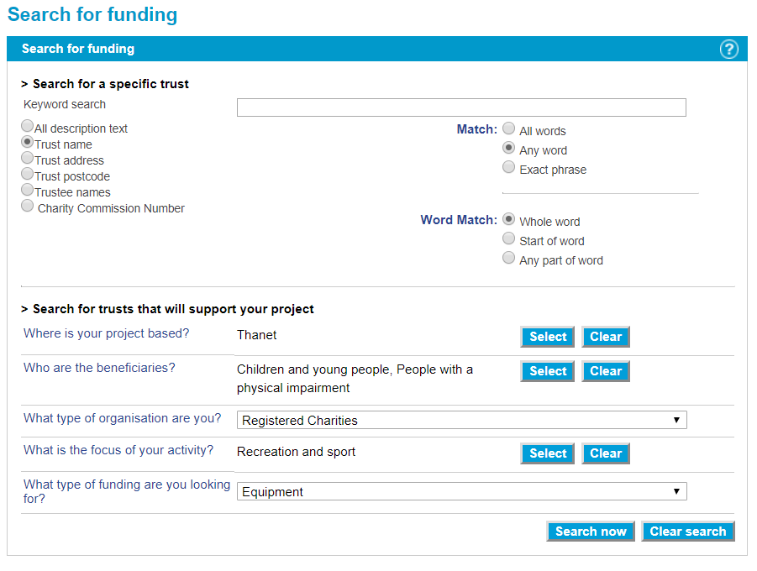

Slide 18
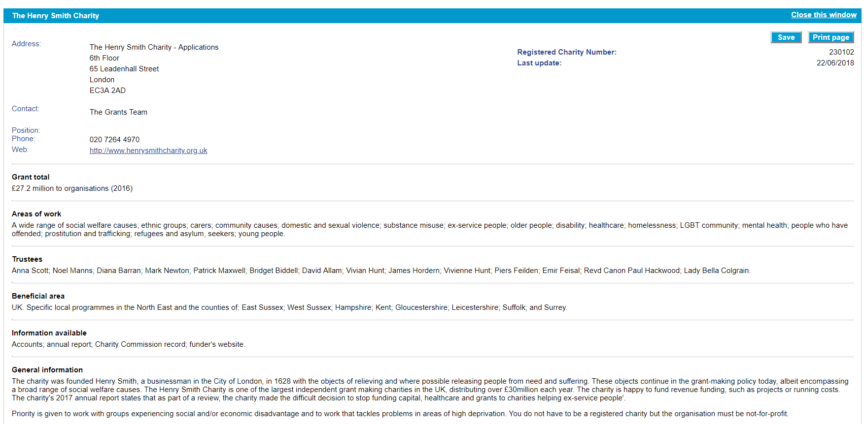

Slide 19
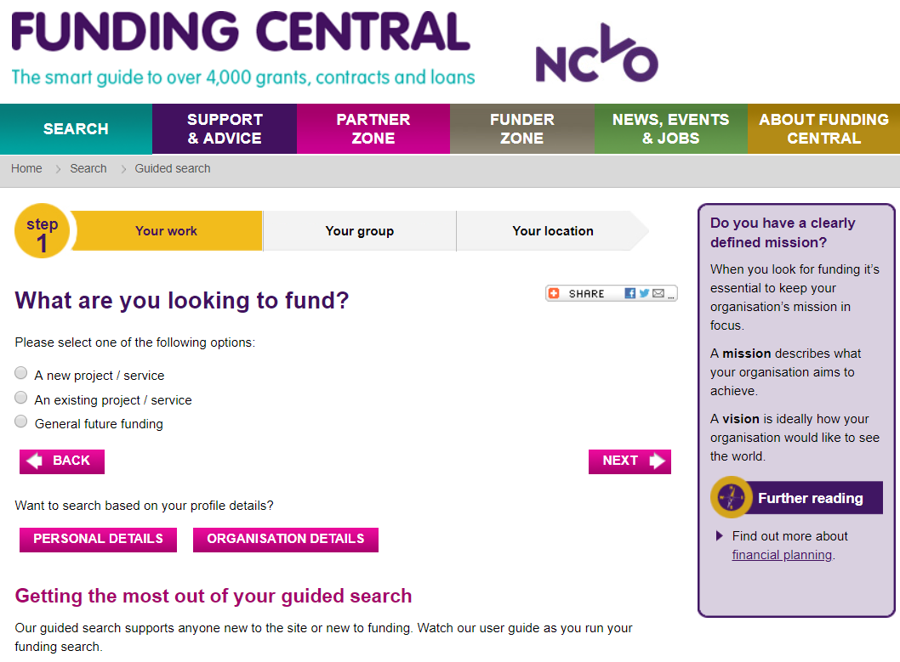

Slide 20
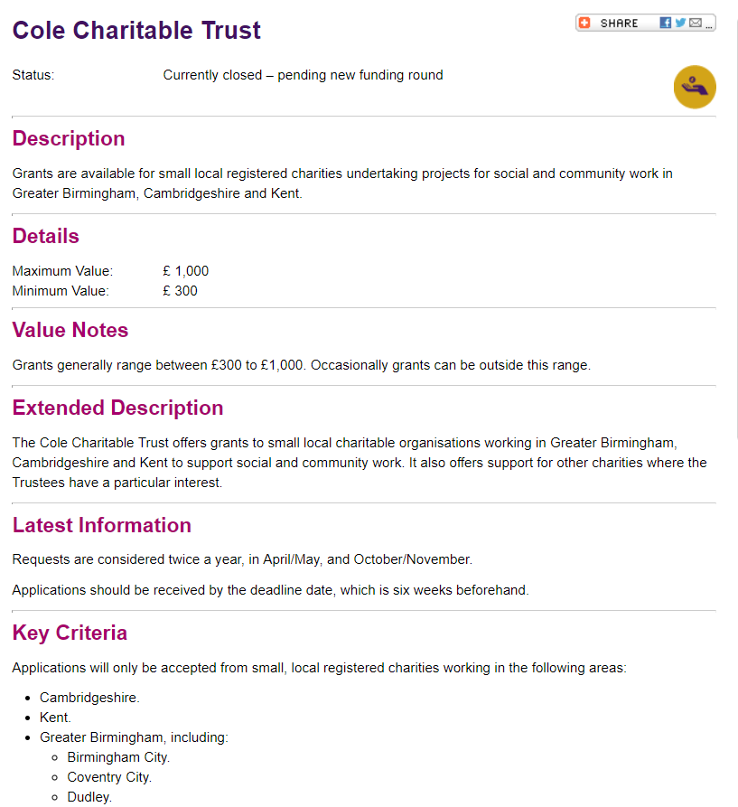

Slide 21
Five key stages of a T&F programme
Establishing funding needs
Prospect research
Developing the case for support
Writing brilliant applications
Record-keeping & relationships
Researching a funder enables you to decide if they fit your organisation, what to apply for, how much, and when. Aim to record:
Name
Contact person and details
Areas of interest
Application method
Application deadline
Average grant size
Relevant previous beneficiaries
Your organisation’s history
This enables you to decide:
Which funding needs are the best fit
How much to apply for
Priority level
Whether / when to apply
You can then develop a prioritised pipeline of prospects to focus on each month / quarter.

Slide 22
Five key stages of a T&F programme
Establishing funding needs
Prospect research
Developing the case for support
Writing brilliant applications
Record-keeping & relationships
The questions your case for support helps you to answer:
Who you are - background info / quick summary about your organisation
Who you help and why - key info about your beneficiaries and the need
What you propose to do about it – activities / outputs
What you will achieve as a result – outcomes / impact
How you will measure this
How much it will cost you – budget
Why your organisation is best placed to achieve this change

Slide 23
Five key stages of a T&F programme
Establishing funding needs
Prospect research
Developing the case for support
Writing brilliant applications
Record-keeping & relationships
What content can help you to answer these questions?
Inputs
Raw content that will interest your donors
Output
A case for support which excites them

Slide 24
Five key stages of a T&F programme
Establishing funding needs
Prospect research
Developing the case for support
Writing brilliant applications
Record-keeping & relationships
Gather up any information that will help you to make your case :
Statistics (about your beneficiaries, their needs, your impact)
Third party research and evidence
Infographics
Photos
Video content
Case studies
Testimonials from staff and beneficiaries
Endorsements from ‘experts’
Awards / formal recognition for your organisation

Slide 25
Five key stages of a T&F programme
Establishing funding needs
Prospect research
Developing the case for support
Writing brilliant applications
Record-keeping & relationships
The questions your case for support helps you to answer:
Who you are - background info / quick summary about your organisation
Who you help and why - key info about your beneficiaries and the need
What you propose to do about it – activities / outputs
What you will achieve as a result – outcomes / impact
How you will measure this
How much it will cost you – budget
Why your organisation is best placed to achieve this change

Slide 26
Five key stages of a T&F programme
Establishing funding needs
Prospect research
Developing the case for support
Writing brilliant applications
Record-keeping & relationships
Creating this bank of content / ‘online filing cabinet’:
Saves you time in the long run by creating reusable content
Builds a much stronger case for support, which enables you to write better applications
Helps you to identify and address any weaknesses / gaps in your projects
Allows you to subsequently apply more quickly, take advantage of last-minute opportunities etc.
Enables you to describe your work in your own words and on your terms

Slide 27
Five key stages of a T&F programme
Establishing funding needs
Prospect research
Developing the case for support
Writing brilliant applications
Record-keeping & relationships
Your own case for support
In your pairs, assume the role of applicant and funder…
Applicants: How will you tell your story to convince the funder of your need?
Funders: You have £20,000 to donate – what info will help inform your decision?
Work together to answer four of the key questions your case for support is built on.

Slide 28
Five key stages of a T&F programme
Establishing funding needs
Prospect research
Developing the case for support
Writing brilliant applications
Record-keeping & relationships
Hand-picking the best funders for your organisation
Draw on all your work so far: funding needs, prospects, case for support
Vital background checks (in batches of 5-10):
  Double check your research: funders can and do change
  Check internal records: previous applications, correspondence and feedback, reporting deadlines
  Check for connections or possible introductions with their trustees
  Are you clear on what to apply for? Does everyone agree?
Take any opportunity to speak to each funder and ask questions – any advice and insight that isn’t publicly available is a huge advantage.

Slide 29
Five key stages of a T&F programme
Establishing funding needs
Prospect research
Developing the case for support
Writing brilliant applications
Record-keeping & relationships
Laying the groundwork for brilliant applications
Be clear on how to apply – application form, written proposal, cover letter?
Identify key criteria / priorities / themes to align your application with
Create a checklist of any supporting materials that you’ll need to provide
Identify any likely challenges or sticking points as early as possible
Identify the deadline and set some key milestones:
  Planning meeting – who needs to be involved?
  Process for drafting and reviewing
  Sign-off process
  Practicalities of submitting it

Slide 30
Five key stages of a T&F programme
Establishing funding needs
Prospect research
Developing the case for support
Writing brilliant applications
Record-keeping & relationships
Application swap shop!
Buddy up and peer review one of your organisation’s applications…
What stands out as particularly strong or successful?
What are the weaker areas and how could they be improved?
What tips / advice would you share to avoid repeating previous mistakes?

Slide 31
Five key stages of a T&F programme
Establishing funding needs
Prospect research
Developing the case for support
Writing brilliant applications
Record-keeping & relationships
Common trusts & foundations mistakes to avoid
1. Taking a punt with a ‘circular’ appeal
Create re-usable content to save time & write stronger applications
Do your research and tailor each application & cover letter accordingly
Don’t be tempted to think of it as a numbers game
2. Making basic mistakes in your applications
Check every funder’s details on their website or on a funding database
Triple check all the basic details – use a checklist if needed
Check every application with a fresh pair of eyes

Slide 32
Five key stages of a T&F programme
Establishing funding needs
Prospect research
Developing the case for support
Writing brilliant applications
Record-keeping & relationships
Common trusts & foundations mistakes to avoid
3. Getting your budget wrong
Triple check your figures! (allow plenty of time for this)
Use a budget calculator tool with formulae to auto-calculate totals
Always ‘show your workings’, especially if multiple people are involved
4. Failing to achieve full cost recovery
Calculate indirect costs for each project – these represent your ‘added value’
Check each funder’s guidance on overhead costs – ask/clarify if needed
If a grant or project puts your organisation’s finances at risk, walk away

Slide 33
Five key stages of a T&F programme
Establishing funding needs
Prospect research
Developing the case for support
Writing brilliant applications
Record-keeping & relationships
Common trusts & foundations mistakes to avoid
5. Ignoring guidelines from a funder
Read everything they’ve published & create a checklist to remind you
Try calling them to check details and ask questions
Demonstrate and apply your knowledge in the application
6. Failing to acknowledge previous support
Check all previous correspondence & grant details before you start
Get your house in order (thanking and reporting) before applying again
Reiterate your thanks & reference previous grants in your cover letters

Slide 34
Five key stages of a T&F programme
Establishing funding needs
Prospect research
Developing the case for support
Writing brilliant applications
Record-keeping & relationships
Common trusts & foundations mistakes to avoid
7. Resorting to technical jargon
Avoid using technical language – remember you’re speaking to a person
Explain everything in the clearest, simplest possible way
Ask a friend or uninformed colleague to give a different perspective
8. Inadvertently talking down your work
Take time to describe your beneficiaries and the need
Use case studies and personal stories to inspire emotion and empathy
Use uncomfortable & shocking information, but carefully!

Slide 35
Five key stages of a T&F programme
Establishing funding needs
Prospect research
Developing the case for support
Writing brilliant applications
Record-keeping & relationships
Organisation skills and attention to detail are essential for trusts fundraising. For every application, aim to record:
Any correspondence you had with the funder (who, when, what)
How much you applied for
What project / funding need you applied for
How you applied, and where the application is stored
When to expect a decision

Slide 36
Five key stages of a T&F programme
Establishing funding needs
Prospect research
Developing the case for support
Writing brilliant applications
Record-keeping & relationships
Once a decision is made on your application, you should also record:
What the outcome was, and when
If successful:
  How much you received
  Reporting requirements and timeframe
  Any conditions attached to the grant
If unsuccessful:
  Any specific feedback that you received
  When you can re-apply

Slide 37
Five key stages of a T&F programme
Establishing funding needs
Prospect research
Developing the case for support
Writing brilliant applications
Record-keeping & relationships
Some general record-keeping tips:
A CRM is ideal, but a well-maintained spreadsheet can be fine
Keep a tidy filing system – name files clearly, use labelled sub-folders, remove old drafts
Scan or store hard-copy correspondence and make sure it is easy to find

Slide 38
Five key stages of a T&F programme
Establishing funding needs
Prospect research
Developing the case for support
Writing brilliant applications
Record-keeping & relationships
Building relationships with funders:
Trusts aren’t faceless organisations – individual people make the decisions!
Always capitalise on opportunities to speak to funders – before, during and after your application.
Provide updates where possible e.g. any changes to your plans, other funding successes, positive news about your project.
Be honest and open about any challenges – funders don’t expect everything to run smoothly, and can sometimes help.
Phone calls are often best for gauging reactions & getting informal advice.
Look for opportunities to keep building relationships e.g. networking events, social media, invitations to see your work in action.

Slide 39
What funders say, what they really mean, and what to do about it

Slide 40
What funders say…
A funder says: “We don’t fund running or salary costs”
They may mean:
They won’t fund running or salary costs as a stand-alone item
They’re seeking tangible projects that can easily be linked to their funding
Funding of this nature doesn’t help them to achieve their goal
They want to fund meaningful project work, not pay to keep people in jobs
How you can respond:
Package your work into projects which include funding for key staff
Adopt a full cost-recovery approach to claim a share of overheads
Careful budgeting will prevent you having to ‘dip in’ to core funding
Identify specialist funders who do fund running and/or salary costs

Slide 41
What funders say…
A funder says: “We only fund new ideas and activities”
They may mean:
They are looking for evidence of innovation
They don’t want to fund the same activities year on year
How you can respond:
Your projects may not be new to you, but are they innovative in your field?
Show the learning process of your project – evolution, lessons learned
Show how new developments (e.g. new evidence or changing political climate) make your current projects more necessary
Could your project be a catalyst for others?
Provide evidence of beneficiary consultation
Speak to and meet with funders

Slide 42
What funders say…
A funder says: “We don’t fund work which is a statutory responsibility”
They may mean:
They don’t want to pick up the slack for government spending cuts.
They’re not interested in funding work which is typically government-funded e.g. residential care, housing, employment support.
How you can respond:
Show your work is different, better or more innovative.
Define your work in terms of what beneficiaries need and why your experience tells you it’s necessary, rather than just presenting it as a substitute for a statutory-funded project.
Demonstrate social return on investment - how does your work save e.g. the NHS money?
Know when to walk away from a funder that simply isn’t the right fit.

Slide 43
What funders say…
A funder says: “We don’t accept unsolicited applications”
They may mean:
The organisation does its own research into the work it wishes to fund
They fund based on personal recommendations
They have received too many poor quality applications in the past
They don’t have the resources to manage large numbers of applications
How you can respond:
Ask their advice – If they have funded similar projects, what can you learn?
Explore relationships – Do you know anyone who can introduce you?
Get noticed – Letter of introduction, annual report, invite them to visit you
Create connections – Do they have a newsletter/social media?

Slide 44
What funders say…
A funder says: “We don’t enter into discussions about funding in advance or provide feedback”
They may mean:
They don’t have the resources to provide this support
They don’t see value in these discussions
They prioritise relationships with the organisations they fund
Feedback can be debateable and create further discussion
Sometimes there is nothing helpful a funder can tell you!

Slide 45
What funders say…
A funder says: “We don’t enter into discussions about funding in advance or provide feedback”
How you can respond:
Research similar projects they have funded
Tap into existing relationships with funders
Read any guidelines carefully
Cast a critical eye over your application – ask someone less familiar with your work
Call a funder to avoid the ‘copy and paste’ email response
Accept that competition is fierce

Slide 46
Questions & final thoughts?
Establishing funding needs
Prospect research
Developing the case for support
Writing brilliant applications
Record-keeping & relationships

Slide 47
What to do next?
Complete the feedback form
Leave contact details to receive follow-up resources and helpsheets
Visit www.limegreenconsulting.co.uk for more information

Slide 48
About Lime Green Consulting
Business planning
Facilitation
Theory of change
Fundraising strategy
Advice & mentoring
Case for support
New campaigns
Grant funding strategy
Prospect research
Template applications
Bid writing

Slide 49
Thank you! www.limegreenconsulting.co.uk
In partnership with:

